Slide 1

2024 Spring SOCI2010 (Education and Society) Tutorial 8
Wanying LING
Department of Sociology
The University of Hong Kong
lingwany@connect.hku.hk
Apr 3, 2024

Slide 2
Updated Tutorial Schedule
Dates | Tutorial
T1 (Jan 31) | • Form groups. • Kick off the group project. • Select an article and start reviewing.
T2 (Feb 7) | • Summarise the article • Sharing topics of interest
T3 (Feb 21) | • Discuss the RQ/hypotheses. • Discuss data collection/analysis methods.
T4 (Feb 28) | • Finalise the RQ/hypotheses. • Discuss data collection/analysis methods.
T5 (Mar 13) | • Discuss data collection/analysis methods. • Finalise data collection/analysis methods.
T6 (Mar 20) | • Sharing of experiences and issues in data collection/data cleansing
T7 (Mar 27) | • Analyse the data - Qualitative (interviews) and quantitative (Descriptive Statistics)
T8 (Apr 3) | • Analyse the data
T9 (Apr 10) | • Analyse the data
T10 (Apr 17) | • Discuss implications. • Prepare presentation slides.
T11 (Apr 24) | • Presentation.

Slide 3

What is Coding?
Assigning
Assigning labels or codes to segments of qualitative data
Organizing and categorizing
Organizing and categorizing data for analysis
Identifying
Identifying patterns, themes, and relationships
Notes:
Today, we'll explore what coding is, different types of coding, the coding process, tips for effective coding, and the benefits of coding in qualitative research.
Coding is a fundamental process in qualitative data analysis. It involves assigning labels or codes to segments of qualitative data, such as text from interviews, focus groups, or open-ended survey responses. The purpose of coding is to organize, categorize, and make sense of the data, enabling researchers to identify patterns, themes, and relationships within the data.

Slide 4
Types of Coding:
Open Coding
Axial Coding
Selective Coding
Initial coding process; identifying and labeling concepts and categories
Relating and connecting categories to each other
Identifying the core category and developing a theoretical framework
Notes:
There are different types of coding used in qualitative research:

Slide 5
Coding Process
Familiarize yourself with the data (read through transcripts, field notes, etc.)
Identify meaningful segments of data (phrases, sentences, paragraphs)
Assign codes to the segments (use descriptive or conceptual labels)
Refine and revise codes as you progress through the data
Group similar codes into categories or themes
Look for patterns, relationships, and connections between categories
Notes:
Now, let's walk through the coding process step by step:

Slide 6

Tips for Effective Coding
Use a consistent and clear coding scheme
Define codes and categories based on the research questions and objectives
Be open to emerging themes and concepts
Regularly review and refine codes and categories
Collaborate with other researchers to ensure reliability and consistency
Use qualitative data analysis software (e.g., NVivo, ATLAS.ti) to facilitate the coding process
Notes:
To ensure effective coding, keep the following tips in mind:

Slide 7

Benefits of Coding
Organizes and simplifies large amounts of qualitative data
Allows for systematic and rigorous analysis
Helps identify patterns, themes, and relationships
Facilitates the development of theoretical frameworks or models
Enhances the credibility and trustworthiness of qualitative research
Notes:
Coding offers several benefits in qualitative research:

Slide 8
Example
"I feel like the teachers here really care about our success. They go out of their way to help us and make sure we understand the material. It makes me feel supported and motivated to do my best."
Supportive teachers
Teacher-student relationships
Motivation and engagement
Positive school climate
Notes:
Suppose you conducted interviews with high school students to explore their experiences and perceptions of their school environment. After transcribing the interviews, you begin the coding process.

Slide 9
Example
"The teacher often calls on the same group of students to answer questions, while others seem disengaged. Some students appear hesitant to participate, possibly due to fear of giving the wrong answer."
Teacher-student interactions
Student participation
Classroom dynamics
Inequitable opportunities
Notes:
Let's say you conducted ethnographic observations in a classroom to study the interactions between teachers and students. You begin coding your field notes to identify patterns and themes.
As you progress with coding, you may identify overarching themes such as the importance of supportive teacher-student relationships, the inequities in classroom interactions.

Slide 10
Linear Regression Expected change in Y per unit X
X = independent (explanatory) variable
Y = dependent (response) variable
Use instead of correlation
when distribution of X is fixed by researcher (i.e., set number at each level of X)
studying functional dependency between X and Y

Slide 11
How formulas determine best line
Distance of points from line = residuals (dotted)
Minimizes sum of square residuals
Least squares regression line

Slide 12
Regression Model (Equation)
“y hat”

Slide 13
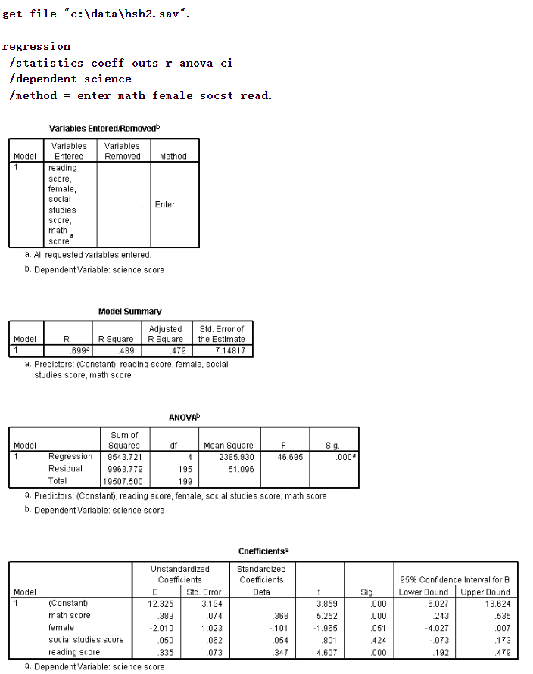
https://stats.oarc.ucla.edu/spss/output/regression-analysis/

Slide 14
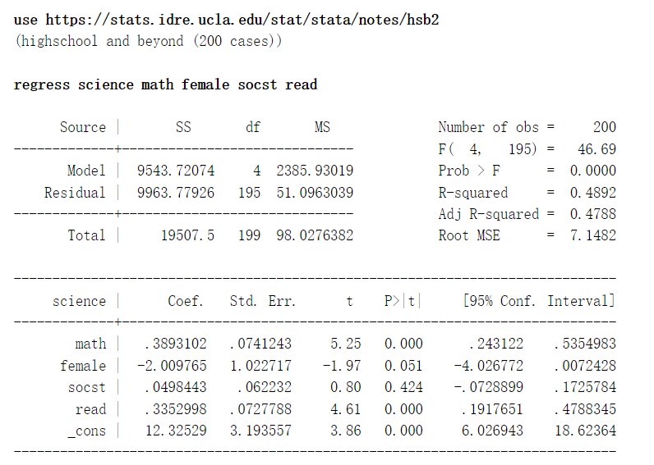
https://stats.oarc.ucla.edu/stata/output/regression-analysis/

Slide 15
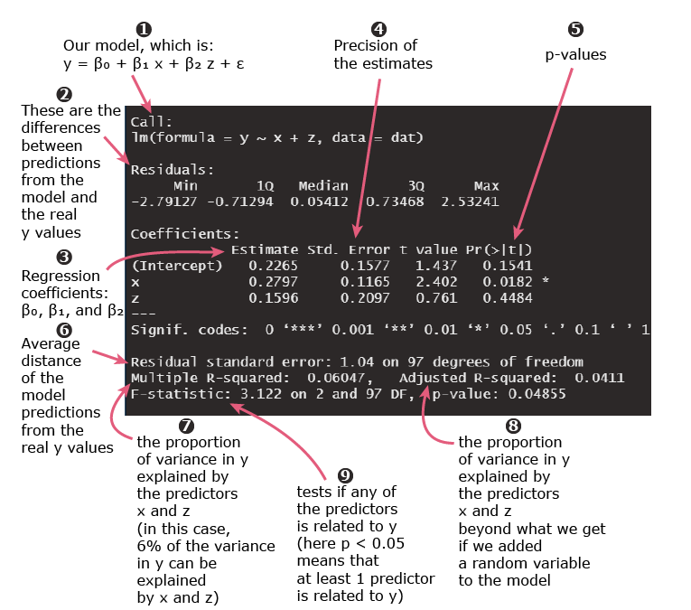
set.seed(1)
# simulating some fake data with a sample size of 100
x = rnorm(100)
z = sample(c(0,1), 100, replace = TRUE)
y = 0.4*x + 0.5*z + rnorm(100)
dat = data.frame(x = x, z = z, y = y)
# linear regression
summary(lm(y ~ x + z, data = dat))
https://quantifyinghealth.com/interpret-linear-regression-output-in-r/

Slide 16

Tell me! (Please remember to select the corresponding date)
https://hku.au1.qualtrics.com/jfe/form/SV_0CAc6wAIyoTfH4W

Slide 17

Thank you!
Wanying Ling
lingwany@connect.hku.hk

